Slide 1
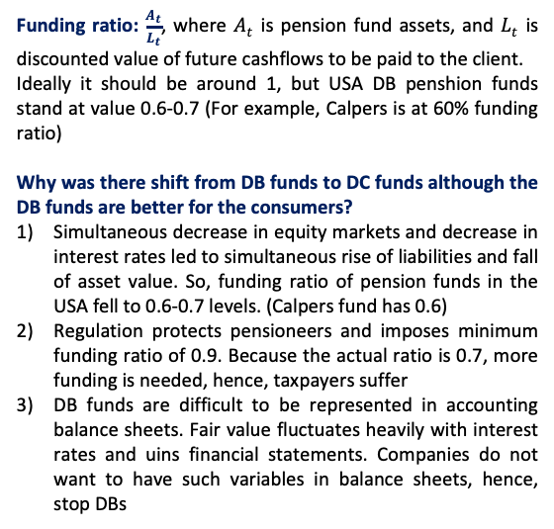
Liability-Driven and Goal-based investing
This is the most existing investment course in the Universe
It builds up on 1st part of EDHEC M2 program
! Remind Lione when we know something so that we go faster
Lione Martellini:
Was director of EDHEC risk institute
Co-founder of scientific beta
Consultant of asset managers
Quantum mechanics
Relativistic astrophysics
Problems of Asset Management in 2024
“Asset management is about supply” is a myth
“We know better than our clients what they need” is a myth
This is B2C business, therefore, asset managers need to know what clients actually need. Currently there are many products that are not needed.
Regulators do not help with the issue, because their main focus is to prevent harmful products from entering the industry.
Pension system doesn’t have a solution
Level 1: social security. Closes the most basic needs of people, includes retirement income. This isncome is insufficient to keep up with current consumption.
Level 2: pension benefits. Benefits from DB or DC pension funds.
Level 3: retirement accounts. Individual’s own savings.
Difined contribution penshion plans (DC) – indicidual makes contribution of some size to the fund, but is not promised to be paid exact sum of money at retirement
Defined benefit penshipn plans (DB) – complany promises to an employee salary while he is working + certain income at retirement. This was the initial scheme to be used. However, it failed.
Aim of the course:
Learn the framework to design & recognize meaningful investment solutions
The problem of the consumer
How many inflows to contribute to achieve target levels of consumtion (outflows) in future (education of kids, retirement income)
… came to talk to a gardener of institution of advanced studies. Gardener says “I have a daughter who is smart. Where should I invest my money to give her this opportunity?” Sadly, he had no meaningful answer. There is not yet solution that is cheap enough and unrisky enough to reach this objective.
If there is a problem, there has to be a solution!
Funding ratio: $\frac{A_{t}}{L_{t}}$, where $A_{t}$ is pension fund assets, and $L_{t}$ is discounted value of future cashflows to be paid to the client.
Ideally it should be around 1, but USA DB penshion funds stand at value 0.6-0.7 (For example, Calpers is at 60% funding ratio)
Why was there shift from DB funds to DC funds although the DB funds are better for the consumers?
Simultaneous decrease in equity markets and decrease in interest rates led to simultaneous rise of liabilities and fall of asset value. So, funding ratio of pension funds in the USA fell to 0.6-0.7 levels. (Calpers fund has 0.6)
Regulation protects pensioneers and imposes minimum funding ratio of 0.9. Because the actual ratio is 0.7, more funding is needed, hence, taxpayers suffer
DB funds are difficult to be represented in accounting balance sheets. Fair value fluctuates heavily with interest rates and uins financial statements. Companies do not want to have such variables in balance sheets, hence, stop DBs
Balanced fund is not a good solution
Funds that maintain fixed proportion between stocks and bonds are not a good solution, because they are suboptimal. They represent static portfolios from QPM course. They do not allow to change allocation based on past information like in myopic portfolios or conduct dynamic hedging.
Target date fund is not good solution either
These funds are built on concept of life path. In the beginning the protfolio is highly invested in equities (when the customer is young), but then slowly decays toward high allocation in bonds. Basic rule of thumb is 100-age of customer allocate to equities.
Creator of the target date funds paper … argues that the idea itself was not fully implemented.
Target date funds are poorly diversified and rewarded. Fixed income component of these funds is not safe and consumes too much risk budget. Allocation is not welfare maximising.
What is the problem with DC funds?
The problem of this fund is inadequate distribution of risks. All market risks lie on consumer while asset manager (that could manage this risk better) does not take risk.
What to do?
Use The Framework

Slide 2




The Framework
The Retirement Dragon
There are 3 main ingredients to create a sound investment strategy. Each Ingredient is a form of risk management
1
The Sword
The sword is PSP (Performance-seeking portfolio).
Its risk-management technique is diversification.
The PSP is “Being smarter by taking risk”. It is finee to take more risk till it is rewarded
As a good sword should be sharp, the PSP performance is measured by Sharpe Ratio
The problem of the sword is to find PSP with maximum SR
Sword is multi-asset, not only equity
VS
2
The Shield
The shield is GHP/LHP (hoal-hedging portfolio / liability-hedging portfolio)
Its risk management technique is hedging
The GHP is about “Being smarter by not taking risk”
This is a “risk-free” asset, a replicating portfolio for income streams that you need to finance (Ladder Bond Portfolio)
It assures minimum acceptable result
The problem of the shield is to find the cheapest replicating portfolio for CFs
The Investment Knight
Fund separation theorem:
Everyone should be holding PSP, GHP, and know utility to decide between 2 (in practice dynamic hedge is instead of utility)
3
The Mastery
$$μ$$
The mastery is about allocation between PSP and GHP
Its risk management technique is insurance
It is about dynamic hedging, cutting downside, buying put option
Robo-advisors can be a solution
PSP
GHP
$$σ Var(\frac{A_{t}}{L_{t }})$$
Current problems of the framework
Equity blocks are mostly wrong. They do not have good Sharpe Ratios. Though there are good passive solutions (QPM course) like parametric portfolio policies. A simple yet effective solution is cap-weighted index. Equally-weighted index and GMV with norm constraints are better than cap-weighted index.
There are no good shields. You need ZC for every maturity, a platform with such product. These ZCs should be exchangable. Exchange coupons.
Personalized solutions for individual clients are missing
History of portfolio management
Pre-historic (Bengamin Graham)
Modern (Markowitz)
Post-Modern (Merton) Solving inter-temporal portfolio problem via continuous time finance
Typical case of an individual
Now he is 55, he will retire in 10 years. He will live for 20 years at retirement.
He has some savings & will make some additional contributions
He has an Essential Goal (EG) – the minimum affordable CFs at retirement
He has Aspirational goal (AG) – the ideal annual replacement income he wants to achieve
Need to design optimal payoff for him & then dynamically replicate it
Business opportunity
Some asset managers may choose to exrtract wealth from individual in form of fees. They do not have to give good solutions if there are no any. Hence, a disruption of the market by good solution may change the situation.
The opportunity is to make provider of investment solutions.

Slide 3
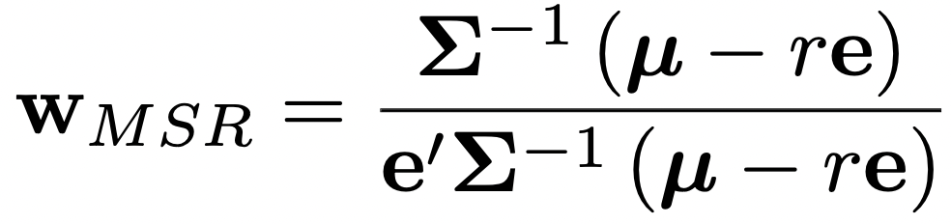
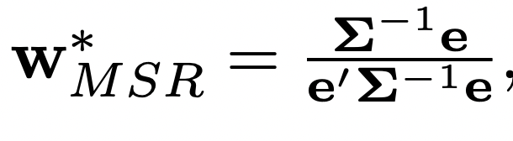
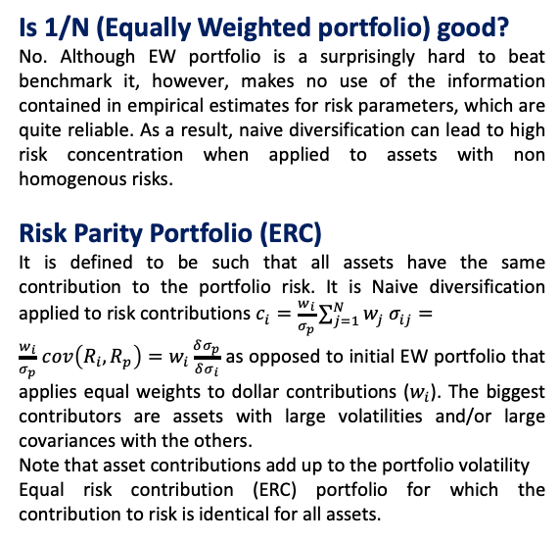
The Sword
Diversification
The risky portfolio should be efficient at harvesting risk premia across and within asset classes: It’s all about diversification!
If one could reliably predict future returns, there would be no need or desire diversification. But it is not possible.
Hence, the goal of diversification is precisely to find the most efficient way to harvest risk premia across and within risky assets.
Is 1/N (Equally Weighted portfolio) good?
No. Although EW portfolio is a surprisingly hard to beat benchmark it, however, makes no use of the information contained in empirical estimates for risk parameters, which are quite reliable. As a result, naive diversification can lead to high risk concentration when applied to assets with non homogenous risks.
Risk Parity Portfolio (ERC)
It is defined to be such that all assets have the same contribution to the portfolio risk. It is Naive diversification applied to risk contributions $c_{i}=\frac{w_{i}}{σ_{p}}\sum_{j=1}^{N}{w_{j}{ σ}_{ij}}=$
$\frac{w_{i}}{σ_{p}}$ $cov\left(R_{i},R_{p}\right)=w_{i}\frac{δσ_{p}}{δσ_{i}}$ as opposed to initial EW portfolio that applies equal weights to dollar contributions ($w_{i}$). The biggest contributors are assets with large volatilities and/or large covariances with the others.
Note that asset contributions add up to the portfolio volatility
Equal risk contribution (ERC) portfolio for which the contribution to risk is identical for all assets.
Excalibur
The best sword is the sharpest sword, so the best diversified portfolio is the maximum Sharpe ratio portfolio, i.e., the portfolio that achieves the highest expected return in excess of the risk-free rate per unit of risk taken.
2-step decision
The investment process is often divided in two steps:
decide how much to allocate across asset classes
decide how much to allocate into individual securities allocate within each class. At the asset class level, the securities are typically aggregated into indices.
Maximum SR portfolio in practice
In Markowitz optimization MSR portfolio (Excalibur) is:
Short-selling constraints
1) All weights should be nonnegative. The primary reason for imposing this condition is that short sales are hardly feasible for most investors, either because buying on margin is costly or simply because short sales are prohibited.
2) Institutional or regulatory reasons may also impose tighter bounds on weights, e.g. by restricting the percentage allocation to a given security or asset class to be less than a cap.
Imposing bounds on weights in a variance minimization program allows to reduce sampling errors in the covariance matrix. This result is formally established by Jagannathan and Ma (2003). Minimizing variance subject to a no short-sales constraint is equivalent to minimizing variance without any weight constraint, but with a modified covariance matrix, in which some of the covariances have been shrunk downwards.
Empirically, they show that when nonnegativity constraints are imposed all estimators of covariance matrixes and monthly or daily sampling frequencies produce roughly the same out-of-sample volatility.
Norm constraints
DeMiguel et al. (2009) pursue the idea of imposing weight constraints, by introducing a more global form of constraints, which they call “norm constraints”:
setting a cap on the amount of leverage, i.e. in setting an upper bound on the sum of negative weights: this nests the no-short sales constraint as a limit case, but allows for a controlled amount of leverage to be taken in case the constraint is relaxed.
the sum of squared weights is capped to a maximum
Empirically, GMV portfolios with ENC (effective number of constituents) constraints have often lower variance and higher Sharpe ratios than GMV portfolios with no short-sales constraints.
Historical estimates do not give reliable values for expected returns of portfolio, because too many observations are required to make the estimates reliable enough. Confidence interval is too wide. For instance, with 20 years of data, the radius of the confidence interval for the annualized expected return is 1.96 × 0.2/√20 = 8.8%.
Covariance matrix can be more reliably estimated, because it depends not only on the number of years of data, but also on the data frequency. Hence, it makes sense to con- sider portfolio construction techniques that only rely upon the easier-to-estimate covariance matrix
Global Minimum Variance (GMV) portfolio
Since sample-based expected return estimates are bound to be unreliable, and given that covariance parameters are some- what easier to estimate, one could be tempted to use portfolio that relies only on risk parameters (GMV portfolio)
But using GMV as a proxy for the MSR assumes identical expected returns, which is not a reasonable prior. It is unrealistic assumption, because expected returns are different because they have different exposure to systematic risks (not because of historical data!). Hence, all mu are not equal, hence, GMV is not the best portfolio
The influential paper of DeMiguel et al. (2009) confirms that portfolios intended as proxies for the true MSR, such as the GMV portfolios, do not systematically display better out-of-sample Sharpe ratios than naive equally-weighted (1/N) portfolios, even when improved estimates are used for the covariance matrix and expected return vectors.
The “magic” of diversification does not work properly for GMV portfolios: low volatility components are not penalized and are substantially over-weighted; minimum volatility does not just give up on estimating expected returns, it also gives up on diversification.

Slide 4
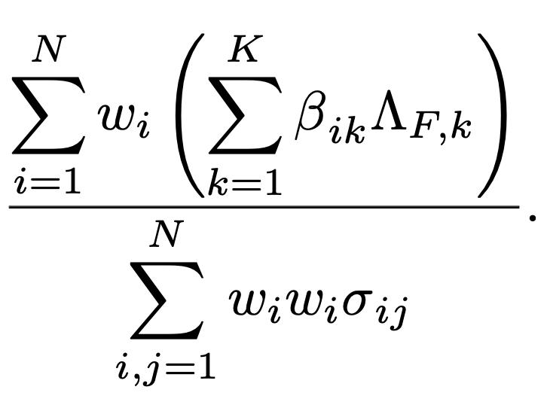
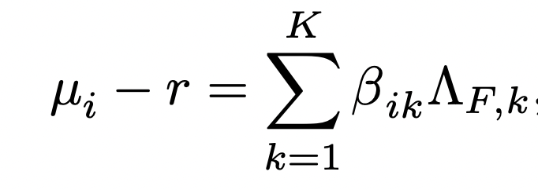
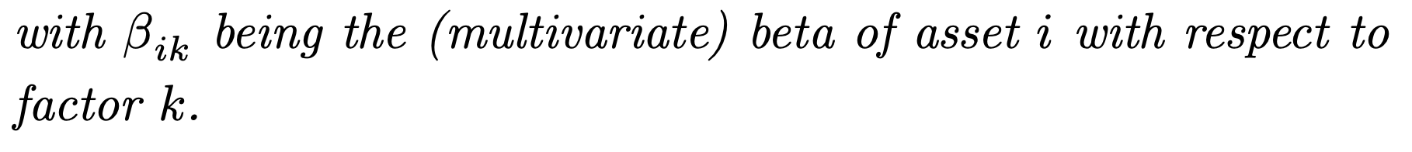
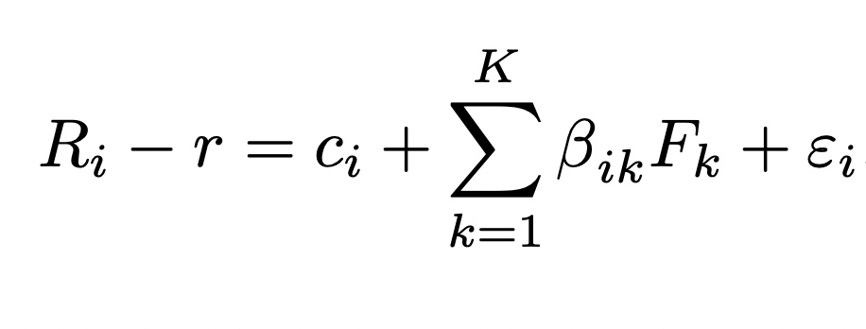
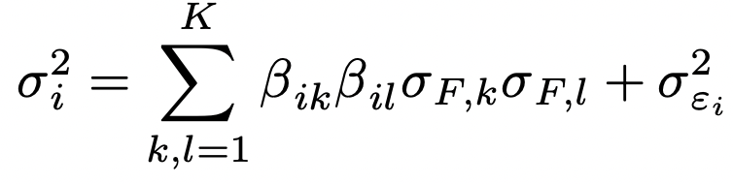
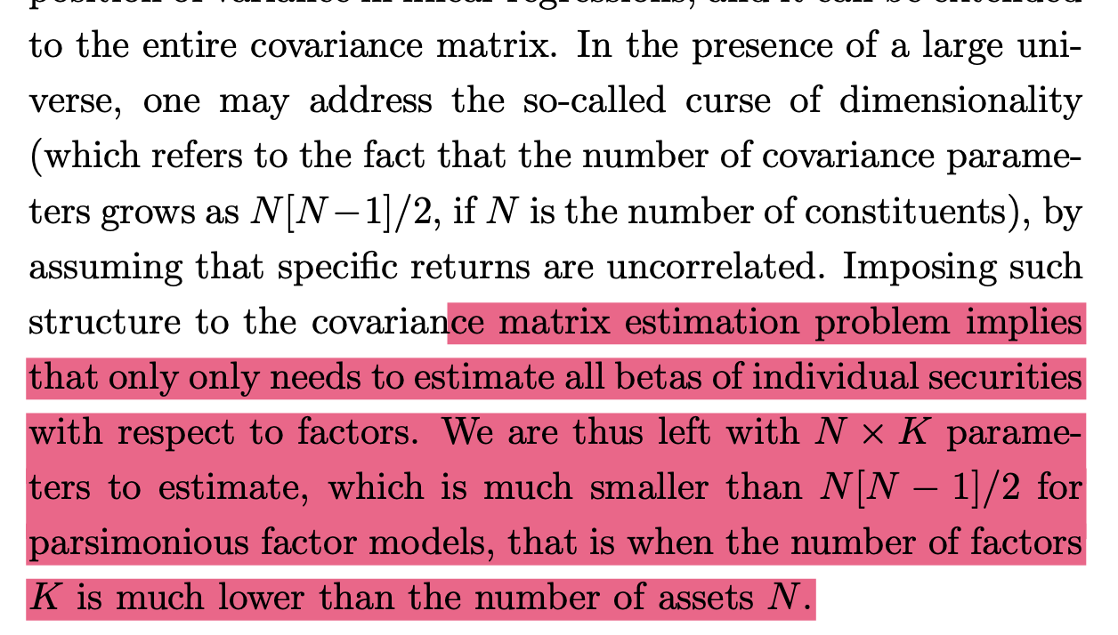
Factor Investing
A “factor” can refer to a strategy that earns an economically justified risk premium in the long run. It can also refer to a common source of risk that affects multiple securities, or to an economic indicator that characterizes market conditions.
A set of random variables are called "asset pricing factors" for a given set of assets if they collectively explain
for these assets cross-sectional differences in expected returns.
Estimation problem
SR of factor
model is
The challenge involved in estimating the expected returns on individual assets has been replaced by the challenge involved in estimating the expected return on systematic factors, which is not any easier from a statistical standpoint
scalar quantities
Problem: no commonly accepted set of factors exist
Within the equity class, more or less consensual explicit factors exist, like the three Fama-French factors (market, size and value) and a few additional factors that were uncovered by academic research (momentum, low volatility, investment and profitability)
factor mimicking portfolios can be regarded as the most meaningful building blocks for investment decisions
Eugene Fama "all we really say in finance is hold diversified portfolios along whatever tilt you choose."
Single factor model
In case there is a single factor, e.g. the market factor for stocks, the single beta coincides with the usual notion of beta from Sharpe’s (1965) Capital Asset Pricing Model (CAPM): it is the covariance with the factor divided by the variance of the factor. With multiple factors, the betas can be estimated by running a linear regression of excess returns on the factors. This is a simple procedure, though its implementation requires some care to address non-stationarity issues (betas vary over time, in fact) and small samples biases (low measured betas are likely to be underestimated while high measured betas are likely to be overstated)
According to the fundamental asset pricing equation, differences in expected returns are explained only by differences in betas. In other words, there can be no source of reward beyond the factors, zero alpha.
Each excess return can be regressed against the factors to be decomposed in a systematic part, which results from the exposures to the factors, and an idiosyncratic part:
More problems so that you fill frustrated
each decentralized asset manager is tasked with managing a sub- component of the whole investor portfolio => no optimal choice
if the manager is in charge of the whole PSP, a pure focus on the expected return and the volatility of their portfolio is only rational in the absence of liabilities. For liability-driven investors, relative risk is a more meaningful objective
personalized suitability within the investment solution under consideration
Optimal PSP can be repre- sented as a combination of several funds, which involves MSR portfolio plus one or more other fund(s). MSR portfolio alone is in general suboptimal. For example , it can be GMV + “most liability-friendly” (MLF) portfolio, which maximizes the correlation with liabilities
Why do not we do GHP portfolio for liabilities?
[for more details see Reading: Precision investing ]
meeting investor needs is the "new alpha”. an ability to produce and distribute suitably designed performance portfolios adapted to liability-driven investor-specific goals and constraints will likely mark a key step forward from the traditional focus on promoting one-size-fits-all products on the basis of their alleged outperformance
Estimation problem
Using the fact that idiosyncratic returns are uncorrelated from factors, we obtain
When the number of assets is large, curse of dimensionality appears and imposes difficulty on covariance matrix estimation.
It is proposed to solve this problem by ??? (did not get the meaning)

Slide 5
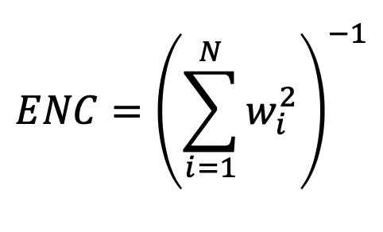
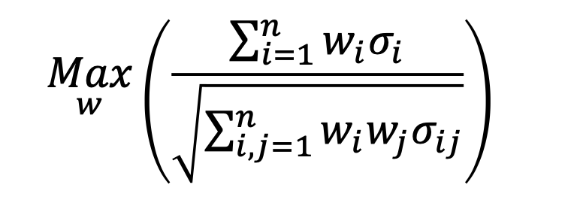


Passive vs Active Portfolio Management (lecture 2)
Passive portfolio replicates the benchmark.
Active portfolio replicates to beat the benchmark. If benchmark is cap-weighted, alpha is always big. But few managers outperform after accounting for fees and survivorship bias. Many of them really are professionals. 82% underperform in long term. % of top 25 asset managers that stayed top 25 is 10% (1.8% in total who did well twice). 40% of them go to worst 25%. Compatible with what B.Graham writes
Before 21 century 100% of assets were actively managed. Passive was invented as an industry recently. Now >40% is passively managed. Since 2006 net inflows in passive and outflows from active happen [from Morningstar direct asset flows].
Open architecture: A bank sells products of everyone. Before it was selling its products from only its Asset Management. But usually in France it works only for private clients (that pay more fees).
Multi-management: Avoiding bad managers instead of selecting good ones.
So, maybe there really is someone who can beat the market consistently. Alternative is to just go passive. Too much fees are also lost => let’s just go passive
Core-satellite: Most funds have core portfolios + 20% of assets in active satellite.
Concentration
Measure of being well-diversified is ENC. W=1 => ENC = 1. The most concentrated portfolio. If w1=wn=1/N => ENC = N
The problem with S&P500 is that it is concentrated.
Random selection also gives better results than S&P500 (because this is 1/N on average)
SR maximization
We cannot do Markowitz, because cannot normally estimate expected returns (confidence intervals are too wide) and because too many constituents => next things was. Fund that was using GMV got a lot of money. But the problem of GMV does not outperform 1/N. Because of curse of dimensionality. Did GMV deliver out-of-sample low vol? Yes. So, actually it was a move in the right direction. But it did not delver Sharpe. If your risk is GMV-like then ok, hold it.
Max decorrelation portfolio
GMV does not use correlation component enough. There is a simple scheme to use with success: do GMV while forcing stocks to have the same volatility. This
Max diversification portfolio
Launched by creator of Tobam company
They were doing max diversification portfolio:
Is cap-weighted portfolio a good sword?
No, it is not! Because:
Cap-weighted indexes are inefficiently diversify unrewarded specific risks due to strong concentration in large cap. You are not rewarded enough for the risk you are taking. You are harvesting only half of what you could have got. It was assumed to be tangency portfolio, but it was misunderstanding of CAPM.
Cap-weighted indexes provide inefficient exposure to rewarded specific risks.
In 2003 Shwartz showed that S&P500 is way worse than an optimal Markowitz portfolio. Of course, it was ex-post in-sample => not that viable. However, the difference of real tangency portfolio and S&P was very big. Therefore, there began a search for a better portfolio.
Also something as naïve as 1/N outperforms S&P500 => this is argument for being bad, not for 1/N being good. So, cap-weighted is an ok proxy to understand the market, but not good portfolio to invest in
Actually it is not max div. portfolio, max ENC portfolio would be max diversified portfolio. This is more of the most balanced portfolio. Really max div. portfolio is MSR.
We do not live in CAPM world, we believe more in multi-factor.
No, we do not: come to lionel and talk about raman’s 2022 paper
Whatever you do you end up holding some factors. Don’t think that if you invest you do not hold some factors, everyone is exposed to some of them willingly or not. So. You have to be aware of knowing what you are exposed to.
The most agnostic prior is “all equal”. This is a fine forporto. It is not max SR portfolio. This can be a good enough portfolio to come up with strategic or tactical lambdas (factors). But I am in a business of custructing a good benchmark. Hence, maybe factors have fine SR.
From 50 years of returns values does better than … => let me use it. On average over next 50 years that can hold. For 20 years people are talking only about Fama French, and this is why I moved to quantum physics.
EW (1/N) can be improved by going in terms of risk. Doing risk parity.
Cmon people, design program so that you know what you give to students. You need to have a plan if you want the program to follow a plan.
$$μ$$
MSR
S&P500
$$σ$$
This was motivation to launch Scientific Beta

Slide 6
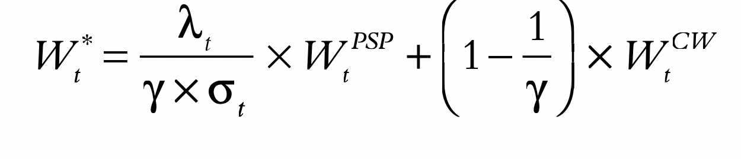
Other problems
Can you do smth like equaly weighted by decrease carbon footprint?
Can you do equally weighted but with low TE from …?
Paper “diversifying the diversifiers”
No strategy from those iscussed actualy outperforms other strategies. => each model behaves well in certain market condition. There are no gurantees that alternative weighting schemes outperform cap-weighted index. => diversifying across these models may help decrease error associated with picking a model.
Researchers find that taking GMV and msr portfolios with weights 50%/50% decreases tracking error.
It can also look like that:
Minimum volatility portfolio performs well in adverse market conditions, MSR provides access to bull runs.
Diversification of rewarded risks
It turns out that cap-weighted can overweight stocks that have wrong factor exposure.
For example, Cap weighted is tilted to large cap by construction. You will have negative beta for cap-weighted on small cap. When you are holding cap-weighted you hold a wrong portfolio. You are paying some premia so smb. Maybe this is ok for some, because they are too big. This premia comes from safety. I don’t want to be stack in small-cap stocks.
Some people say that EW has small cap bias.
What about value premia? CW or EW have a bias towards it?
Negative exposure to value factor.
Cap weighted was bad, because it was missing several risk-premia. It holds risk that is negatively rewarded. It is not only 0 risk premia, but also pays risk premia.
What scientific beta has been good at:
In 2005 everybody realized cap-weighted is bad. In 2010 smart-beta appeared (GMV, risk-parities, etc.)
GMV and ERC tend to be safe portfolios and overweight global stocks. Their beta is 0.8, it is defensive portfolio. Should you be happy or not holding strategically with it? No, because I am harvesting 80% of risk premia.
What you may want to do is doing GMV or ERC constrained to have beta 1.
In 2008-2010 they were becoming frustrated, because people were not paying attention to factor exposures. For example, how about momentum? Cap-weighted has better exposure to MOM. In EW winners are sold, losers are bought. Scientific beta was among the first to say “ok, we are better now than cap-weighted. What about factor exposures?” Got message from MSCI ”these guys now complain about negative exposure to momentum. But do not worry, we MSCI have answer to everything. Particularly if you want momentum, just buy good old cap-weighted.” What is wrong about this statement? It is bad, because (eujen fama told it to us): diversify portfolio along the tilt that you choose. If you want to harvest risk premia, just choose it and hold diversified portfolios along that tilt. So, for momentum exposure you manually identify past winners and hold them, past losers you do not hold. Allocation to past winners should be diversified: harvest full premia by holding past winners & holding smart beta like risk parity.
Why we care about factor exposures and not sector exposures?
Because they come with risk premia.
These premias exist because you can loose a lot of money.
Stocks tend to go down at the worst possible time. But this is not the case for bonds.

Slide 7
Investors Need to Understand the Risks of Smart Beta
Smart beta investments are funds and ETFs that have a non-traditional weighting scheme that goes beyond cap weighting. There are many different types out there — equal-weighted, inversely risk-weighted, optimized to minimize risk, fundamental-weighted, factor tilts, dividend tilts, and dividend-weighted ETFs. There’s a whole taxonomy out there.
Would I include smart beta in participant retirement plans? Possibly, but you have to select low-cost versions implementing well-known ideas that have been demonstrated to work over a long time and in different markets, like a value tilt. That’s a pretty solid factor. That’s one of the best ones out there.
If you are a retail investor, you are typically not sophisticated, and you respond to marketing and hype. It’s our job as investment managers to be honest with these investors and really explain performance beyond the hype. They have to know the risks and the rewards of investing in these products, and there are risks. The term smart beta is a great marketing slogan, and it has caught on.
You may have a period of massive underperformance of a particular strategy. There’s a lot of academic research that says that actively managed funds collectively underperform passive cap-weighted indices in the long run. Vanguard founder John Bogle thinks that everything that’s not an index fund is a fraud. But does it mean that the market is truly efficient and there are no anomalies? No. There are anomalies. And there are risks — mainly, that any strategy will underperform. Let’s say everybody in the world piles into value strategies. Then value will stop working.
The market-cap-weighted index is the only index that can theoretically be held by every investor in the market. You will all get the same exposure. But in the real world, there will always be some winners and some losers.
I’d say hybrid products that erase the boundary between active management and smart beta are where things are headed. Those are truly multi-factor, risk-aware investment strategies.
We live in a low-yield environment with investors who are desperate to outperform the traditional indices and asset classes, so I think marketing has a huge role to play in whether or not these hybrid products catch on.
Beware of risks. Beware of costs. Invest in more robust ideas, like value. Momentum isn’t robust. On that basis, my heart lies with lower-cost solutions that offer you a cheap value tilt.
Source: Nick Baturin
https://www.linkedin.com/in/nickbaturin/

Slide 8
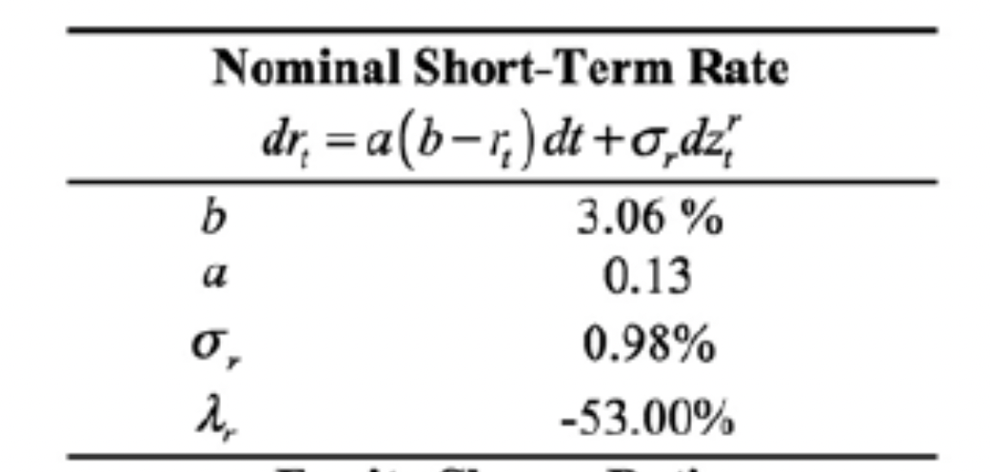


Questions
1) If we are in the world where:
$$μ$$
PSP
GHP
$$σ Var(\frac{A_{t}}{L_{t }})$$
Should the SR be not the main metric?
2) Is separation of PSP on 2 funds about that?
3) Who is creator of the target date fund paper? What is the name of the paper?
4) What to do with Heston volatility, it does not behave well
5) You said that cap weighted is bad. But ramans paper of 2022 with SDFs shows that 95% of systematic risk variance is explained by cap weighted portfolio. While systematic risk accounts for 30% of total risk. Is it really that bad?
6) Can you give info about the full case? I need to see the full picture
7) Why relativistic astrophysics and quantum mechanics?
How do I actually choose factors?
Unsystematic is 60% explained by other factors through
8) What asset managers to pick in France?
9) What is difference of usual factor policy and ppp? Need to have a look at raman’s class and get some python notebook on that.
In our simulations what should be correlation of SR and stock volatility
What is lambda r? (asked chat GPT and got the answer)
+ check the correlation matrix with lionel!!!
Some useful advices and inspirational speech
Opportunity cost. You do not pay anybody to keep your eggs at home.
You do not leave your car at home if you can drive across smb
Never ever buy structured products! Stay away from that. Never buy guaranteed payoff, because they are too expensive.
Thank Lionel, same info as Volodin gave me.
You can implement something better. Dynamic portfolio strategies.
“You are sitting on top of accumulated knowledge. My job is to make sure you use them all well. Knowledge given by Raman and Dominic”
I also can be in disagreement with raman or you, it will lead to good discussions.
Note for self: говоря о PSP как о мече, можно фехтовать

Slide 9
CASE
1) We pick some factors we like and some stocks we like and weight them
Mixture of 5 weighteing schemes is a bit smarter than each of them on their own.
You construct smart factor
Then you allocate. To allocate you use same principles

